Slide 1
Mobile Communications
Satellite Systems
Prof. Dr.-Ing. Jochen Schiller, http://www.jochenschiller.de/ MC SS02 7.<number>
Notes:
Freie Universität Berlin
Institut of Computer Science
Mobile Communications
2002
Prof. Dr.-Ing. Jochen Schiller

Slide 2
History of satellite communication
1945 Arthur C. Clarke publishes an essay about „Extra Terrestrial Relays“
1957 first satellite SPUTNIK
1960 first reflecting communication satellite ECHO
1963 first geostationary satellite SYNCOM
1965 first commercial geostationary satellite Satellit „Early Bird“ (INTELSAT I): 240 duplex telephone channels or 1 TV channel, 1.5 years lifetime
1976 three MARISAT satellites for maritime communication
1982 first mobile satellite telephone system INMARSAT-A
1988 first satellite system for mobile phones and data communication INMARSAT-C
1993 first digital satellite telephone system
1998 global satellite systems for small mobile phones
Prof. Dr.-Ing. Jochen Schiller, http://www.jochenschiller.de/ MC SS02 7.<number>

Slide 3
Applications
Traditionally
  weather satellites
  radio and TV broadcast satellites
  military satellites
  satellites for navigation and localization (e.g., GPS)
Telecommunication
  global telephone connections
  backbone for global networks
  connections for communication in remote places or underdeveloped areas
  global mobile communication
➔ satellite systems to extend cellular phone systems (e.g., GSM or AMPS)
replaced by fiber optics
Prof. Dr.-Ing. Jochen Schiller, http://www.jochenschiller.de/ MC SS02 7.<number>

Slide 4
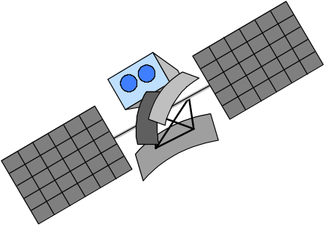
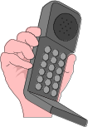



Classical satellite systems
Inter Satellite Link (ISL)
Mobile User Link (MUL)
Gateway Link (GWL)
MUL
GWL
small cells (spotbeams)
base station
or gateway
footprint
ISDN
PSTN
GSM
PSTN: Public Switched
Telephone Network
User data
Prof. Dr.-Ing. Jochen Schiller, http://www.jochenschiller.de/ MC SS02 7.<number>
Notes:
Freie Universität Berlin
Institut of Computer Science
Mobile Communications
2002
Prof. Dr.-Ing. Jochen Schiller

Slide 5
Basics
elliptical or circular orbits
complete rotation time depends on distance satellite-earth
inclination: angle between orbit and equator
elevation: angle between satellite and horizon
LOS (Line of Sight) to the satellite necessary for connection
  ➔ high elevation needed, less absorption due to e.g. buildings
Uplink: connection base station - satellite
Downlink: connection satellite - base station
typically separated frequencies for uplink and downlink
  transponder used for sending/receiving and shifting of frequencies
  transparent transponder: only shift of frequencies
  regenerative transponder: additionally signal regeneration
Prof. Dr.-Ing. Jochen Schiller, http://www.jochenschiller.de/ MC SS02 7.<number>

Slide 6
Elevation
Elevation:
angle ε between center of satellite beam
and surface
minimal elevation:
elevation needed at least
to communicate with the satellite
ε
footprint
Prof. Dr.-Ing. Jochen Schiller, http://www.jochenschiller.de/ MC SS02 7.<number>

Slide 7
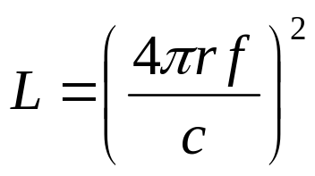
Link budget of satellites
Parameters like attenuation or received power determined by four parameters:
sending power
gain of sending antenna
distance between sender
and receiver
gain of receiving antenna
Problems
varying strength of received signal due to multipath propagation
interruptions due to shadowing of signal (no LOS)
Possible solutions
Link Margin to eliminate variations in signal strength
satellite diversity (usage of several visible satellites at the same time) helps to use less sending power
L: Loss
f: carrier frequency
r: distance
c: speed of light
Prof. Dr.-Ing. Jochen Schiller, http://www.jochenschiller.de/ MC SS02 7.<number>

Slide 8



Atmospheric attenuation
Attenuation of
the signal in %
Example: satellite systems at 4-6 GHz
50
40
rain absorption
30
ε
fog absorption
20
10
atmospheric absorption
5°
10°
20°
30°
40°
50°
elevation of the satellite
Prof. Dr.-Ing. Jochen Schiller, http://www.jochenschiller.de/ MC SS02 7.<number>

Slide 9
Orbits I
Four different types of satellite orbits can be identified depending on the shape and diameter of the orbit:
GEO: geostationary orbit, ca. 36000 km above earth surface
LEO (Low Earth Orbit): ca. 500 - 1500 km
MEO (Medium Earth Orbit) or ICO (Intermediate Circular Orbit): ca. 6000 - 20000 km
HEO (Highly Elliptical Orbit) elliptical orbits
Prof. Dr.-Ing. Jochen Schiller, http://www.jochenschiller.de/ MC SS02 7.<number>

Slide 10
Orbits II
GEO (Inmarsat)
HEO
MEO (ICO)
LEO
(Globalstar,
Irdium)
inner and outer Van
Allen belts
earth
1000
10000
Van-Allen-Belts:
ionized particles
2000 - 6000 km and
15000 - 30000 km
above earth surface
35768
km
Prof. Dr.-Ing. Jochen Schiller, http://www.jochenschiller.de/ MC SS02 7.<number>

Slide 11
Geostationary satellites
Orbit 35.786 km distance to earth surface, orbit in equatorial plane (inclination 0°)
➔ complete rotation exactly one day, satellite is synchronous to earth rotation
fix antenna positions, no adjusting necessary
satellites typically have a large footprint (up to 34% of earth surface!), therefore difficult to reuse frequencies
bad elevations in areas with latitude above 60° due to fixed position above the equator
high transmit power needed
high latency due to long distance (ca. 275 ms)
➔ not useful for global coverage for small mobile phones and data transmission, typically used for radio and TV transmission
Prof. Dr.-Ing. Jochen Schiller, http://www.jochenschiller.de/ MC SS02 7.<number>

Slide 12
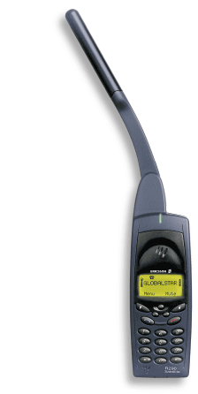

LEO systems
Orbit ca. 500 - 1500 km above earth surface
visibility of a satellite ca. 10 - 40 minutes
global radio coverage possible
latency comparable with terrestrial long distance
connections, ca. 5 - 10 ms
smaller footprints, better frequency reuse
but now handover necessary from one satellite to another
many satellites necessary for global coverage
more complex systems due to moving satellites
Examples:
Iridium (start 1998, 66 satellites)
  Bankruptcy in 2000, deal with US DoD (free use,
  saving from “deorbiting”)
Globalstar (start 1999, 48 satellites)
  Not many customers (2001: 44000), low stand-by times for mobiles
Prof. Dr.-Ing. Jochen Schiller, http://www.jochenschiller.de/ MC SS02 7.<number>

Slide 13
MEO systems
Orbit ca. 5000 - 12000 km above earth surface
comparison with LEO systems:
slower moving satellites
less satellites needed
simpler system design
for many connections no hand-over needed
higher latency, ca. 70 - 80 ms
higher sending power needed
special antennas for small footprints needed
Example:
ICO (Intermediate Circular Orbit, Inmarsat) start ca. 2000
  Bankruptcy, planned joint ventures with Teledesic, Ellipso – cancelled again,
Prof. Dr.-Ing. Jochen Schiller, http://www.jochenschiller.de/ MC SS02 7.<number>

Slide 14
Handover in satellite systems
Several additional situations for handover in satellite systems compared to cellular terrestrial mobile phone networks caused by the movement of the satellites
  Intra satellite handover
    handover from one spot beam to another
    mobile station still in the footprint of the satellite, but in another cell
  Inter satellite handover
    handover from one satellite to another satellite
    mobile station leaves the footprint of one satellite
  Gateway handover
    Handover from one gateway to another
    mobile station still in the footprint of a satellite, but gateway leaves the footprint
  Inter system handover
    Handover from the satellite network to a terrestrial cellular network
    mobile station can reach a terrestrial network again which might be cheaper, has a lower latency etc.
Prof. Dr.-Ing. Jochen Schiller, http://www.jochenschiller.de/ MC SS02 7.<number>
Notes:
Freie Universität Berlin
Institut of Computer Science
Mobile Communications
2002
Prof. Dr.-Ing. Jochen Schiller

Slide 15
Mobile Communications
Bluetooth
Prof. Dr.-Ing. Jochen Schiller, http://www.jochenschiller.de/ MC SS02 7.<number>
Notes:
Freie Universität Berlin
Institut of Computer Science
Mobile Communications
2002
Prof. Dr.-Ing. Jochen Schiller

Slide 16
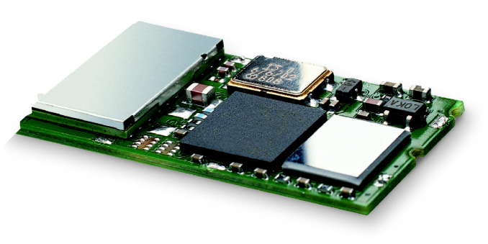




Bluetooth
Idea
  Universal radio interface for ad-hoc wireless connectivity
  Interconnecting computer and peripherals, handheld devices, PDAs, cell phones – replacement of IrDA
  Embedded in other devices, goal: 5€/device
  Short range (10 m), low power consumption, license-free 2.45 GHz ISM
  Voice and data transmission, approx. 1 Mbit/s gross data rate
One of the first modules (Ericsson).
Prof. Dr.-Ing. Jochen Schiller, http://www.jochenschiller.de/ MC SS02 7.<number>
Notes:
Freie Universität Berlin
Institut of Computer Science
Mobile Communications
2002
Prof. Dr.-Ing. Jochen Schiller

Slide 17

Bluetooth
History
  1994: Ericsson (Mattison/Haartsen), “MC-link” project
  Renaming of the project: Bluetooth according to Harald “Blåtand” Gormsen [son of Gorm], King of Denmark in the 10th century
  1998: foundation of Bluetooth SIG, www.bluetooth.org
  1999: erection of a rune stone at Ercisson/Lund ;-)
  2001: first consumer products for mass market, spec. version 1.1 released
Special Interest Group
  Original founding members: Ericsson, Intel, IBM, Nokia, Toshiba
  Added promoters: 3Com, Agere (was: Lucent), Microsoft, Motorola
  > 2500 members
  Common specification and certification of products
(was: )
Prof. Dr.-Ing. Jochen Schiller, http://www.jochenschiller.de/ MC SS02 7.<number>
Notes:
Freie Universität Berlin
Institut of Computer Science
Mobile Communications
2002
Prof. Dr.-Ing. Jochen Schiller

Slide 18
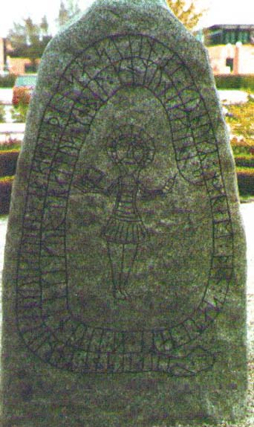
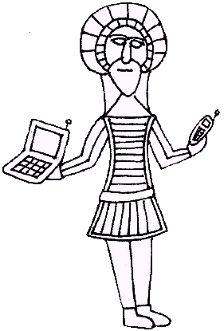
History and hi-tech…
1999:
Ericsson mobile communications AB reste denna sten till minne av Harald Blåtand, som fick ge sitt namn åt en ny teknologi för trådlös, mobil kommunikation.
Prof. Dr.-Ing. Jochen Schiller, http://www.jochenschiller.de/ MC SS02 7.<number>
Notes:
Freie Universität Berlin
Institut of Computer Science
Mobile Communications
2002
Prof. Dr.-Ing. Jochen Schiller

Slide 19
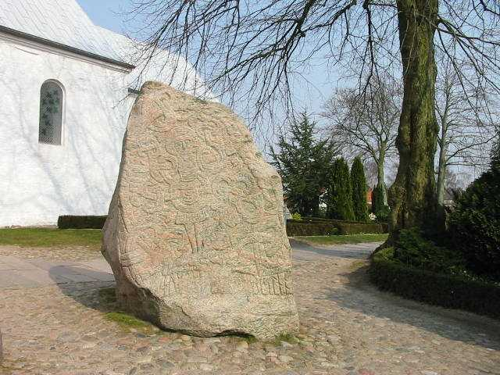
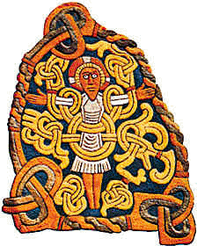
…and the real rune stone
Located in Jelling, Denmark,
erected by King Harald “Blåtand”
in memory of his parents.
The stone has three sides – one side
showing a picture of Christ.
Inscription:
"Harald king executes these sepulchral monuments after Gorm, his father and Thyra, his mother. The Harald who won the whole of Denmark and Norway and turned the Danes to Christianity."
This could be the “original” colors of the stone.
Inscription:
“auk tani karthi kristna” (and made the Danes Christians)
Btw: Blåtand means “of dark complexion”
(not having a blue tooth…)
Prof. Dr.-Ing. Jochen Schiller, http://www.jochenschiller.de/ MC SS02 7.<number>
Notes:
Freie Universität Berlin
Institut of Computer Science
Mobile Communications
2002
Prof. Dr.-Ing. Jochen Schiller

Slide 20
Characteristics
  2.4 GHz ISM band, 79 (23) RF channels, 1 MHz carrier spacing
  Channel 0: 2402 MHz … channel 78: 2480 MHz
  G-FSK modulation, 1-100 mW transmit power
FHSS and TDD
  Frequency hopping with 1600 hops/s
  Hopping sequence in a pseudo random fashion, determined by a master
  Time division duplex for send/receive separation
Voice link – SCO (Synchronous Connection Oriented)
  FEC (forward error correction), no retransmission, 64 kbit/s duplex, point-to-point, circuit switched
Data link – ACL (Asynchronous ConnectionLess)
  Asynchronous, fast acknowledge, point-to-multipoint, up to 433.9 kbit/s symmetric or 723.2/57.6 kbit/s asymmetric, packet switched
Topology
  Overlapping piconets (stars) forming a scatternet
Prof. Dr.-Ing. Jochen Schiller, http://www.jochenschiller.de/ MC SS02 7.<number>
Notes:
Freie Universität Berlin
Institut of Computer Science
Mobile Communications
2002
Prof. Dr.-Ing. Jochen Schiller

Slide 21
Piconet
Collection of devices connected in an ad hoc fashion
One unit acts as master and the others as slaves for the lifetime of the piconet
Master determines hopping pattern, slaves have to synchronize
Each piconet has a unique hopping pattern
Participation in a piconet = synchronization to hopping sequence
Each piconet has one master and up to 7 simultaneous slaves (> 200 could be parked)
P
S
S
M
P
SB
S
P
SB
M=Master
S=Slave
P=Parked
SB=Standby
Prof. Dr.-Ing. Jochen Schiller, http://www.jochenschiller.de/ MC SS02 7.<number>
Notes:
Freie Universität Berlin
Institut of Computer Science
Mobile Communications
2002
Prof. Dr.-Ing. Jochen Schiller

Slide 22
Forming a piconet
All devices in a piconet hop together
  Master gives slaves its clock and device ID
    Hopping pattern: determined by device ID (48 bit, unique worldwide)
    Phase in hopping pattern determined by clock
Addressing
  Active Member Address (AMA, 3 bit)
  Parked Member Address (PMA, 8 bit)


•
P

S
SB

SB

S


SB


M
P
SB
SB




SB
S


SB
SB


P
SB
SB
SB
Prof. Dr.-Ing. Jochen Schiller, http://www.jochenschiller.de/ MC SS02 7.<number>
Notes:
Freie Universität Berlin
Institut of Computer Science
Mobile Communications
2002
Prof. Dr.-Ing. Jochen Schiller

Slide 23
Scatternet
Linking of multiple co-located piconets through the sharing of common master or slave devices
  Devices can be slave in one piconet and master of another
Communication between piconets
  Devices jumping back and forth between the piconets
Piconets
(each with a
capacity of
< 1 Mbit/s)
P
S
S
S
P
P
M
M
SB
S
M=Master
S=Slave
P=Parked
SB=Standby
P
SB
SB
S
Prof. Dr.-Ing. Jochen Schiller, http://www.jochenschiller.de/ MC SS02 7.<number>
Notes:
Freie Universität Berlin
Institut of Computer Science
Mobile Communications
2002
Prof. Dr.-Ing. Jochen Schiller

Slide 24
Bluetooth protocol stack
audio apps.
vCal/vCard
NW apps.
telephony apps.
mgmnt. apps.
OBEX
TCP/UDP
AT modem
commands
TCS BIN
SDP
Control
IP
PPP/BNEP
Audio
RFCOMM (serial line interface)
Logical Link Control and Adaptation Protocol (L2CAP)
Host
Controller
Interface
Link Manager
Baseband
Radio
AT: attention sequence
OBEX: object exchange
TCS BIN: telephony control protocol specification – binary
BNEP: Bluetooth network encapsulation protocol
SDP: service discovery protocol
RFCOMM: radio frequency comm.
Prof. Dr.-Ing. Jochen Schiller, http://www.jochenschiller.de/ MC SS02 7.<number>
Notes:
Freie Universität Berlin
Institut of Computer Science
Mobile Communications
2002
Prof. Dr.-Ing. Jochen Schiller

Slide 25
Baseband
Piconet/channel definition
Low-level packet definition
  Access code
    Channel, device access, e.g., derived from master
  Packet header
    1/3-FEC, active member address (broadcast + 7 slaves), link type, alternating bit ARQ/SEQ, checksum
(typo in the
standard!)
68(72)
54
0-2744
bits
access code
packet header
payload
4
64
(4)
3
4
1
1
1
8
bits
preamble
sync.
(trailer)
AM address
type
flow
ARQN
SEQN
HEC
Prof. Dr.-Ing. Jochen Schiller, http://www.jochenschiller.de/ MC SS02 7.<number>
Notes:
Freie Universität Berlin
Institut of Computer Science
Mobile Communications
2002
Prof. Dr.-Ing. Jochen Schiller

Slide 26
SCO payload types
payload (30)
HV1
audio (10)
FEC (20)
HV2
audio (20)
FEC (10)
HV3
audio (30)
DV
audio (10)
header (1)
payload (0-9)
2/3 FEC
CRC (2)
(bytes)
Prof. Dr.-Ing. Jochen Schiller, http://www.jochenschiller.de/ MC SS02 7.<number>

Slide 27
ACL Payload types
payload (0-343)
header (1/2)
payload (0-339)
CRC (2)
DM1
header (1)
payload (0-17)
2/3 FEC
CRC (2)
DH1
header (1)
payload (0-27)
CRC (2)
(bytes)
DM3
header (2)
payload (0-121)
2/3 FEC
CRC (2)
DH3
header (2)
payload (0-183)
CRC (2)
DM5
header (2)
payload (0-224)
2/3 FEC
CRC (2)
DH5
header (2)
payload (0-339)
CRC (2)
AUX1
header (1)
payload (0-29)
Prof. Dr.-Ing. Jochen Schiller, http://www.jochenschiller.de/ MC SS02 7.<number>

Slide 28
Baseband data rates
Payload User Symmetric Asymmetric
Header Payload max. Rate max. Rate [kbit/s]
Type [byte] [byte] FEC CRC [kbit/s] Forward Reverse
DM1 1 0-17 2/3 yes 108.8 108.8 108.8
DH1 1 0-27 no yes 172.8 172.8 172.8
DM3 2 0-121 2/3 yes 258.1 387.2 54.4
DH3 2 0-183 no yes 390.4 585.6 86.4
DM5 2 0-224 2/3 yes 286.7 477.8 36.3
DH5 2 0-339 no yes 433.9 723.2 57.6
AUX1 1 0-29 no no 185.6 185.6 185.6
HV1 na 10 1/3 no 64.0
HV2 na 20 2/3 no 64.0
HV3 na 30 no no 64.0
DV 1 D 10+(0-9) D 2/3 D yes D 64.0+57.6 D
ACL
1 slot
3 slot
5 slot
SCO
Data Medium/High rate, High-quality Voice, Data and Voice
Prof. Dr.-Ing. Jochen Schiller, http://www.jochenschiller.de/ MC SS02 7.<number>
Notes:
Freie Universität Berlin
Institut of Computer Science
Mobile Communications
2002
Prof. Dr.-Ing. Jochen Schiller

Slide 29
Baseband link types
Polling-based TDD packet transmission
  625µs slots, master polls slaves
SCO (Synchronous Connection Oriented) – Voice
  Periodic single slot packet assignment, 64 kbit/s full-duplex, point-to-point
ACL (Asynchronous ConnectionLess) – Data
  Variable packet size (1,3,5 slots), asymmetric bandwidth, point-to-multipoint
SCO
ACL
SCO
ACL
SCO
ACL
SCO
ACL
MASTER
f₀
f₄
f₆
f₈
f₁₂
f₁₄
f₁₈
f₂₀
SLAVE 1
f₁
f₇
f₉
f₁₃
f₁₉
SLAVE 2
f₅
f₁₇
f₂₁
Prof. Dr.-Ing. Jochen Schiller, http://www.jochenschiller.de/ MC SS02 7.<number>
Notes:
Freie Universität Berlin
Institut of Computer Science
Mobile Communications
2002
Prof. Dr.-Ing. Jochen Schiller

Slide 30
Robustness
Slow frequency hopping with hopping patterns determined by a master
  Protection from interference on certain frequencies
  Separation from other piconets (FH-CDMA)
Retransmission
  ACL only, very fast
Forward Error Correction
  SCO and ACL
NAK
ACK
MASTER
A
C
C
F
H
SLAVE 1
B
D
E
SLAVE 2
G
G
Prof. Dr.-Ing. Jochen Schiller, http://www.jochenschiller.de/ MC SS02 7.<number>
Notes:
Freie Universität Berlin
Institut of Computer Science
Mobile Communications
2002
Prof. Dr.-Ing. Jochen Schiller

Slide 31
Baseband states of a Bluetooth device
standby
unconnected
detach
inquiry
page
connecting
transmit
AMA
connected
AMA
active
park
PMA
hold
AMA
sniff
AMA
low power
Standby: do nothing
Inquire: search for other devices
Page: connect to a specific device
Connected: participate in a piconet
Park: release AMA, get PMA
Sniff: listen periodically, not each slot
Hold: stop ACL, SCO still possible, possibly
participate in another piconet
Prof. Dr.-Ing. Jochen Schiller, http://www.jochenschiller.de/ MC SS02 7.<number>
Notes:
Freie Universität Berlin
Institut of Computer Science
Mobile Communications
2002
Prof. Dr.-Ing. Jochen Schiller

Slide 32
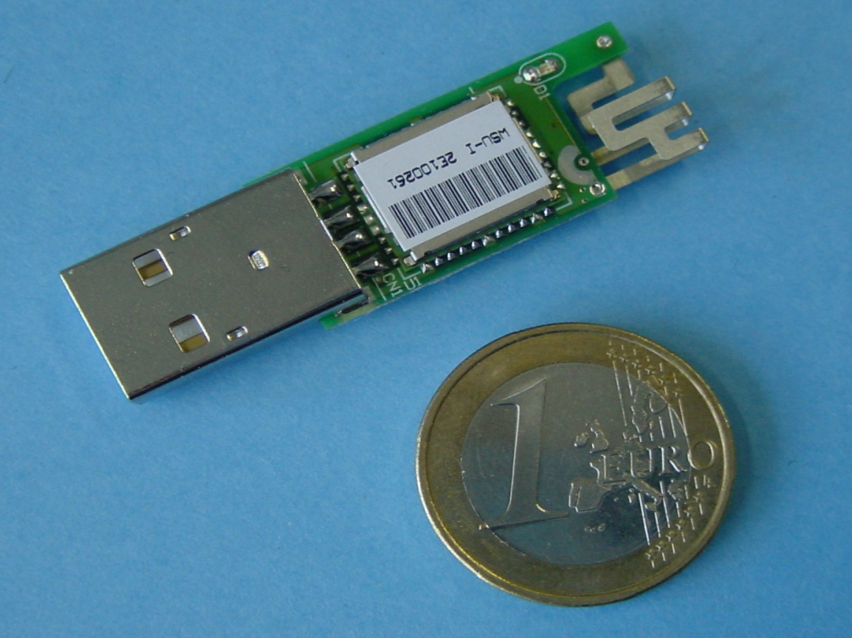
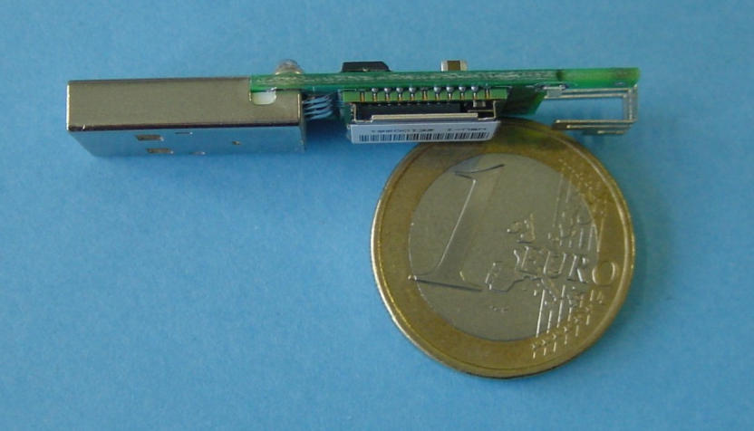
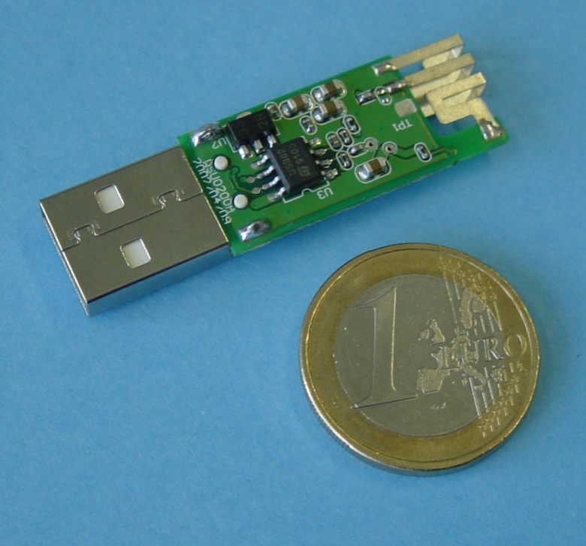
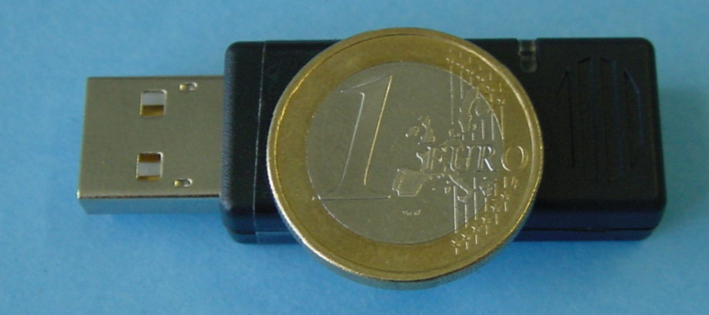
Example: Bluetooth/USB adapter
Prof. Dr.-Ing. Jochen Schiller, http://www.jochenschiller.de/ MC SS02 7.<number>

Slide 33
SDP – Service Discovery Protocol
Inquiry/response protocol for discovering services
  Searching for and browsing services in radio proximity
  Adapted to the highly dynamic environment
  Can be complemented by others like SLP, Jini, Salutation, …
  Defines discovery only, not the usage of services
  Caching of discovered services
  Gradual discovery
Service record format
  Information about services provided by attributes
  Attributes are composed of an 16 bit ID (name) and a value
  values may be derived from 128 bit Universally Unique Identifiers (UUID)
Prof. Dr.-Ing. Jochen Schiller, http://www.jochenschiller.de/ MC SS02 7.<number>
Notes:
Freie Universität Berlin
Institut of Computer Science
Mobile Communications
2002
Prof. Dr.-Ing. Jochen Schiller

Slide 34
Additional protocols to support legacy protocols/apps.
RFCOMM
  Emulation of a serial port (supports a large base of legacy applications)
  Allows multiple ports over a single physical channel
Telephony Control Protocol Specification (TCS)
  Call control (setup, release)
  Group management
OBEX
  Exchange of objects, IrDA replacement
WAP
  Interacting with applications on cellular phones
Prof. Dr.-Ing. Jochen Schiller, http://www.jochenschiller.de/ MC SS02 7.<number>
Notes:
Freie Universität Berlin
Institut of Computer Science
Mobile Communications
2002
Prof. Dr.-Ing. Jochen Schiller

Slide 35
Profiles
Represent default solutions for a certain usage model
  Vertical slice through the protocol stack
  Basis for interoperability
Generic Access Profile
Service Discovery Application Profile
Cordless Telephony Profile
Intercom Profile
Serial Port Profile
Headset Profile
Dial-up Networking Profile
Fax Profile
LAN Access Profile
Generic Object Exchange Profile
Object Push Profile
File Transfer Profile
Synchronization Profile
Applications
Protocols
Additional Profiles
Advanced Audio Distribution
PAN
Audio Video Remote Control
Basic Printing
Basic Imaging
Extended Service Discovery
Generic Audio Video Distribution
Hands Free
Hardcopy Cable Replacement
Profiles
Prof. Dr.-Ing. Jochen Schiller, http://www.jochenschiller.de/ MC SS02 7.<number>
Notes:
Freie Universität Berlin
Institut of Computer Science
Mobile Communications
2002
Prof. Dr.-Ing. Jochen Schiller

Slide 36
WPAN: IEEE 802.15-1 – Bluetooth
Data rate
  Synchronous, connection-oriented: 64 kbit/s
  Asynchronous, connectionless
    433.9 kbit/s symmetric
    723.2 / 57.6 kbit/s asymmetric
Transmission range
  POS (Personal Operating Space) up to 10 m
  with special transceivers up to 100 m
Frequency
  Free 2.4 GHz ISM-band
Security
  Challenge/response (SAFER+), hopping sequence
Cost
  20€ adapter, drop to 5€ if integrated
Availability
  Integrated into some products, several vendors
Connection set-up time
  Depends on power-mode
  Max. 2.56s, avg. 0.64s
Quality of Service
  Guarantees, ARQ/FEC
Manageability
  Public/private keys needed, key management not specified, simple system integration
Special Advantages/Disadvantages
  Advantage: already integrated into several products, available worldwide, free ISM-band, several vendors, simple system, simple ad-hoc networking, peer to peer, scatternets
  Disadvantage: interference on ISM-band, limited range, max. 8 devices/network&master, high set-up latency
Prof. Dr.-Ing. Jochen Schiller, http://www.jochenschiller.de/ MC SS02 7.<number>
Notes:
Freie Universität Berlin
Institut of Computer Science
Mobile Communications
2002
Prof. Dr.-Ing. Jochen Schiller

